Slide 1
SolarAid
A business-based
approach to an
environmental problem
Pippa Palmer
Interim Managing Director
Notes:
Intro and thanks – note limit of 15 minutes = speed and Q&A at end

Slide 2
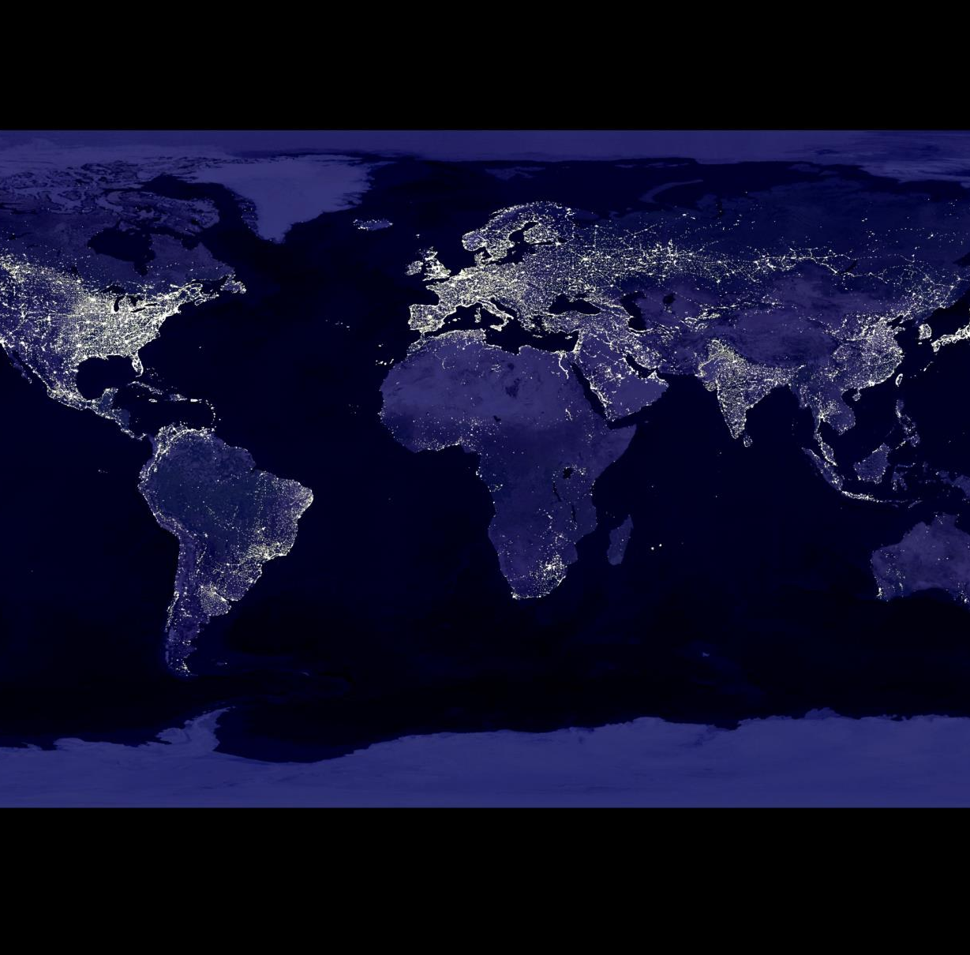
The issue: 600 million in Africa have no access to electricity
$15bn aid outstripped by $18bn oil imports
Fragile, insufficient energy infrastructure
Mains, smart-, mini-grids = $bns investment
A long time coming – if at all
Top down policies ignore remote off-grid users and lack the local context
Notes:
In sub-Saharan Africa only 9% of the rural population has access to electricity. That’s 600 million people without grid access, relying on kerosene, candles, wood for light and cooking. Will rise to 652bn by 2030.
Access to energy for lighting is linked to economic and social development (security, social interactions, money spent on lighting, time for study or income-generating activities, poor health from using certain types of lighting)
The importance of energy access is reiterated in the recent Post-2015 Development Agenda
Goal 1: Eradicate poverty item 1a states: Bring the number of people living on less than $1.25 a day to zero
Goal 7: Secure Sustainable Enegy, item 7b states: Ensure universal access to modern energy services.
Ruth Davis, chief policy adviser at Greenpeace UK, said: "People in poorer countries are being hit twice by the oil industry. They are the first to suffer the impacts of climate change, while their economies are blighted by the rising cost of imported fuel. Instead of giving taxpayer handouts to the fossil fuel industry through World Bank aid programmes and Export Credit Guarantee schemes, countries like the UK should be investing in renewable energy and energy efficiency projects in developing countries, which will improve access to energy for the poor and help build stronger economies.”
Mini-grids expansion – fraught with policy and regulatory issues, large infrastructure expenditure; many ‘dollar a day’ BoP can’t afford to ‘sign up’ – relies on input from end user and government subsidy to cover capitalization cost cost.
Mini-grids: although they are often considered a decentralized energy supply solution for rural community electrification, traditional mini-grids rely on extensive planning periods, high capital costs, and medium-scale centralized generation and distribution technologies of a relatively complex nature. Literature shows that a principle problem facing both mini-grid deployments and extensions of central grid connections to remote areas is the inability to recover associated capital costs …. The costs for infrastructure of this scale become quickly prohibitive over long distances, project timelines are uncertain, and point-to-point infrastructure can be highly susceptible to natural disasters
Timeframe is to 2050 – the people of Africa need power NOW

Slide 3
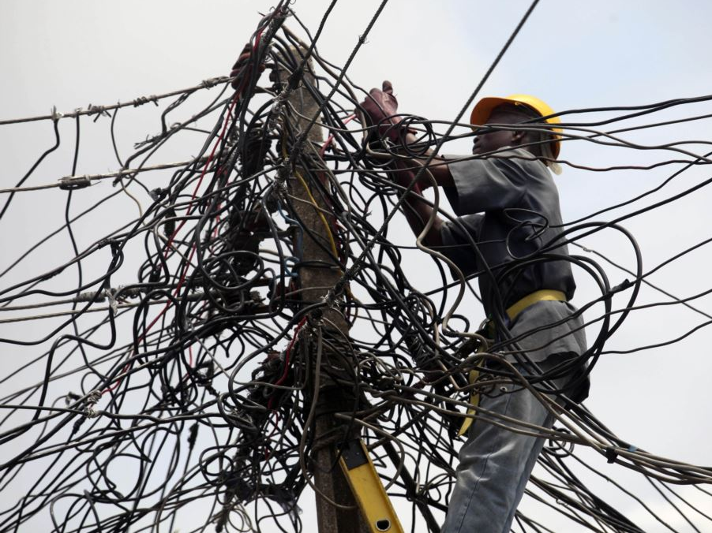
The answer: Bottom up, demand-led solutions, that fit the end-user context
Notes:
Let’s take a step back and look at what that context is for bottom of the pyramid, remote rural users, with no energy access and no hope of a grid or mini-grid in the foreseeable future.
What’s life in off-grid Africa right now …

Slide 4
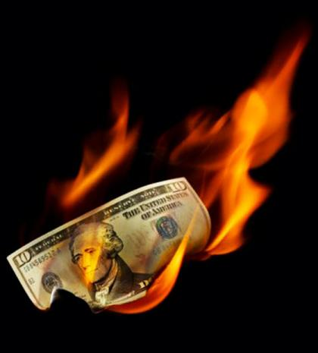
The reality: kerosene lamps
Prohibitively expensive
Doesn’t support evening work or study
Bad for respiratory health
Hazardous (burns, poisonings)
Environmentally damaging
Notes:
Nearly 60 million of those without grid access are using kerosene to light their homes – around 90% in Kenya and Malawi, for example
But kerosene is…….
Expensive: it can account for around 25% of someone’s income and that’s obviously even more significant if you live on less than $1 a day.
Doesn’t support evening study: the light it gives off is low quality (dim) and children complain of eye irritation and strain. Women and female children excluded from light
Women – recent study in Peru showed 13-14 times more likelihood of contracting TB (Kirk et al)

Slide 5
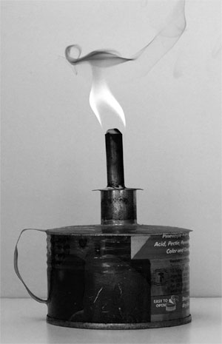
The environment: black carbon
Wick lamps a greater contributor to global warming (20x previous estimates)
7-9% BC conversion v wood @ 0.5%
89% particulate escapes the home
No equalising / mitigating emissions
Responsible for 3% of BC emissions globally
Notes:
Black Carbon – a bigger global warming contributor than we realized
Black carbon (BC) is a powerful absorber of sunlight. A particle rather than a greenhouse gas, it is the second largest climate warmer in today’s atmosphere, following carbon dioxide (CO2).
Environmental scientists have recently calculated that the unburnt black particulate from residential kerosene lighting contributes exponentially to global warming.
A new practical ‘5 lab’ study suggests a twentyfold increase in estimates of black carbon emissions from kerosene-fuelled lighting. (The problem is much greater than previously realised)
How black carbon is formed
Black carbon is a byproduct of incomplete combustion, due to the low burning temperature of wick lamps
On burning, 7-9% of kerosene via wick lamps v .5% of wood is converted to ‘carbonaceous particulate matter’ (soot). (The same ‘soot’ that gets deep into the lungs)
On burning, wick kerosene lamps produce only black carbon, and none of the other gases that offset the negative effect.
Additionally, Lam et al’s experiments show that about 89% of all black carbon emitted by devises used inside of the house escapes outside, i.e. into the atmosphere where it has a micro and macro climatic impact.
The black carbon effect is different to that of CO₂
The effect of black carbon warming is immediate and short term (rather than accumulative / long term with CO₂)
Black carbon (soot) from kerosene lamps hangs in the air (for days, months) where it absorbs the sun and causes atmospheric temperature increases that immediately and directly contribute to climatic warming.
(Which also means removal of black carbon sources, such as kerosene lamps can have an immediate positive effect; whereas CO₂ emissions linger for a 100 year life span)
Macro and micro climate effects
Black carbon has a macro and micro climate effect (hot spots, warming → snow / ice)
Black carbon emissions “peak close to major source regions and give rise to regional hotspots of black carbon—induced atmospheric solar heating.” Such hotspots include “the Indo-Gangetic plains in South Asia; eastern China; most of Southeast Asia including Indonesia; regions of Africa between sub-Sahara and South Africa; Mexico and Central America; and most of Brazil and Peru in South America.”
Approximately three billion people live in these hotspots.
Black carbon causes temperature changes that produce a variety of environmental impacts on human, plant and animal ecosystems. In addition,vbecause black carbon is a form of particulate matter, which is a category of emissions linked to premature mortality and disability
Removal
In developed countries with better infrastructure, the main sources of black carbon are diesel vehicles and industrial emissions (regulated / trapped → time / cost)
In undeveloped countries with poor infrastructure, the main sources of black carbon emissions are fossil fuels and biomass burning (impossible to regulate → replacement)
Kerosene lamps account for as much as 3% of global black carbon emissions

Slide 6
Black Carbon: climate effects
Short life (days/weeks) v CO₂ (100yrs)
1g of BC reflections = 10 black umbrellas
BC warms the atmosphere many times more in days/weeks than 1g of CO₂ over 100yrs
270,000 metric tons BC emitted per annum
Macro and micro climate impacts
Notes:
One gram of BC dispersed in the atmosphere absorbs about as much light as 10 black umbrellas.
Although black carbon remains in the atmosphere for only a few days, one gram of black carbon warms the atmosphere several hundred times more during its short lifetime than one gram of carbon dioxide does during 100 years.
One kilogram of black carbon, a by-product of incomplete combustion, produces as much warming in a month as 700 kilograms of carbon dioxide (CO₂) does over 100 years. (Lam et al, 2012:4; Bond et al 2011).
This new data puts the CO₂ emissions saved per lamp per year into a totally new perspective – we've been pre-occupied with CO₂ molehills, when in fact it is the mountainous impact of black carbon that makes the eradication of the kerosene lamp so very urgent for our planet and its people.
Sources

Slide 7
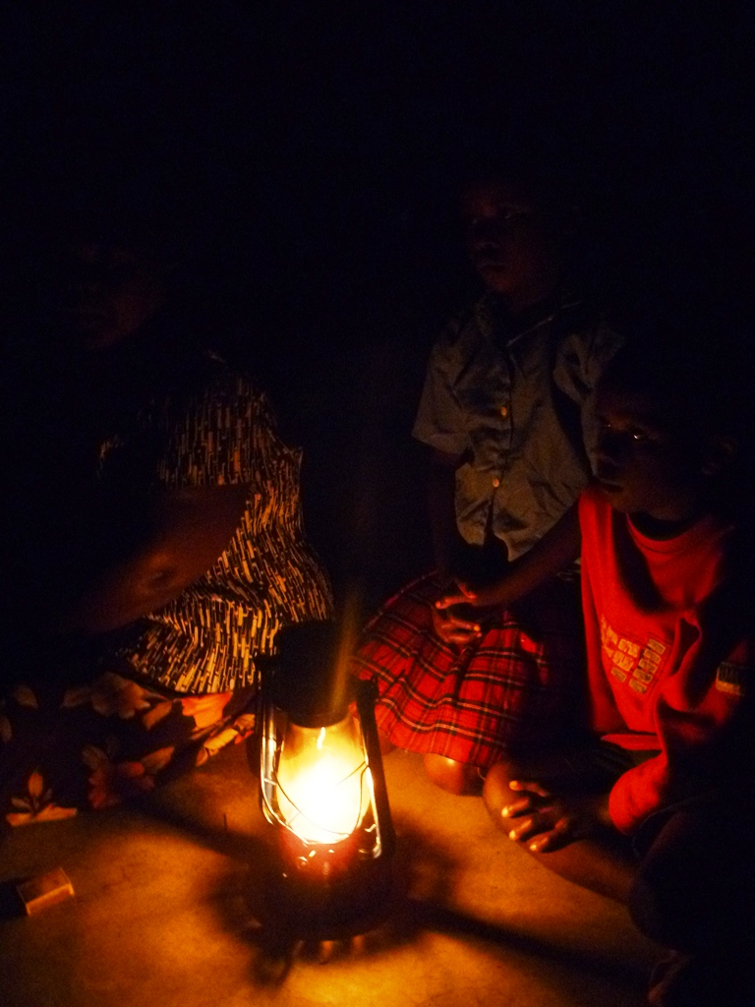
Kerosene lamps: “low hanging fruit”
There are no magic bullets that will solve all of our greenhouse gas problems, but replacing kerosene lamps is low-hanging fruit, and we don’t have many examples of that in the climate world,”
Prof Kirk Smith, UC Berkeley’s School of Public Health / Director of the Global Health and Environment Program.
Notes:
“There are many inexpensive, cleaner alternatives to kerosene lamps that are available now, and few if any barriers to switching to them.”
This new data puts the CO₂ emissions saved per lamp per year into a totally new perspective – we've been pre-occupied with CO₂ molehills, when in fact it is the mountainous impact of black carbon that makes the eradication of the kerosene lamp so very urgent for our planet and its people.

Slide 8
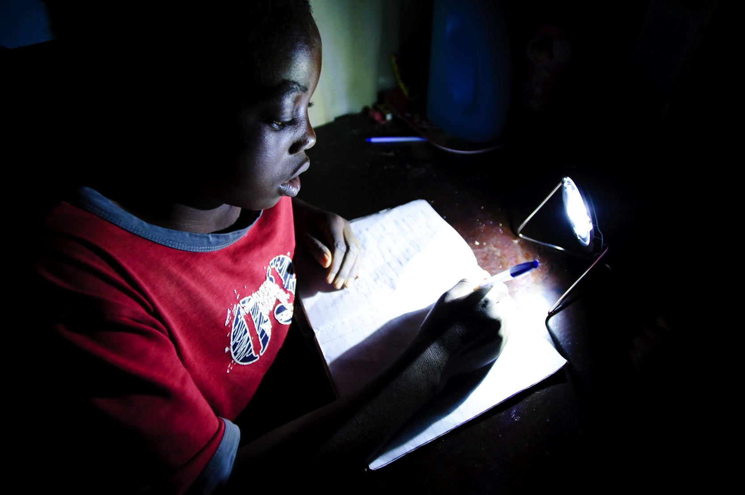
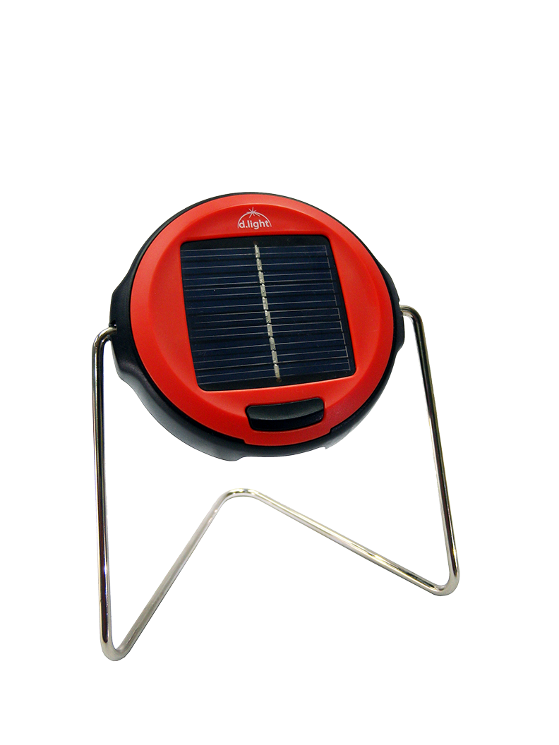
The answer: “the power of pico”
Cheap
Bright
Durable / warranty
Long lifespan
No tech transfer / red tape
Notes:
Demonstrate light – integrated PV, rechargeable battery and LED (or detachable panel) …. Can charge phones.
Technological advances
Solar Home Systems are end-user based generation (solar photovoltaics), storage and energy management units that run basic loads
such as lighting and cell phone chargers. Larger systems also allow loads such as televisions, laptops, refrigerators, however (for now) the usage of mechanical appliances is limited.
Source: Research Group – Microenergy Systems (MES) Mini-Grid Research Team An Impulse for a Discussion on Mini-Grids and Electrification
Contact of the Mini-Grid Research Team: Brian Edlefsen Lasch; mini-grid@microenergy-systems.de

Slide 9
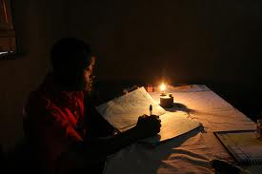
Kerosene lamp
Kerosene lamp
Solar light
Notes:
Here’s a little example of what it’s like to try and read in the dark with a kerosene lamp

Slide 10
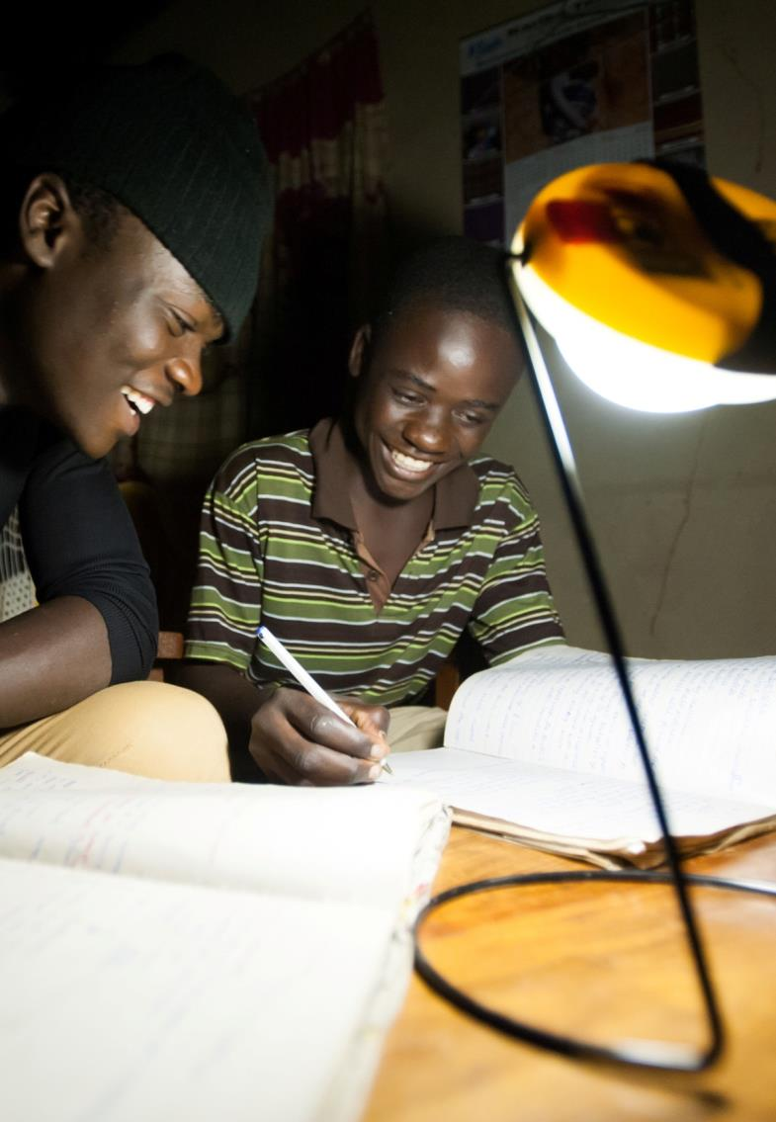
Kerosene lamp
Kerosene lamp
Solar light
Notes:
And here’s the difference with a solar light ….

Slide 11
Switch to solar: multiple uplifts
Families save money
Spent on nutrition, schooling, business
Improved educational outcomes
Reduced CO₂ and black carbon emissions
Improved well-being: family socialising, dignity, resilience, safety
Notes:
As a result of buying a solar light our field research shows:
- families save money from reduced kerosene use and saving. In Kenya, households save nearly £74 a year, on average. Savings are commonly spent on food, school costs and investing in business/farming.
- because the lights are bright, safe, clean and motivational and don’t cost anything to maintain, children study for longer. Children in Malawi are doing two hours more homework a night, on average. 96% of teachers have noticed a difference in students with solar lights; two-thirds talked about increased performance as well as attendance, concentration and motivation.
- because households are reducing kerosene use as a result of buying a solar light nearly all solar light users in Kenya noticed an improvement in health; less coughing, chest problems and eye irritations.
- one kerosene lamp produces up to 200 kg of CO₂ emissions a year. A solar light replaces the use of one kerosene lamp in Tanzania; so that’s a lot of reduced pollution in aggregate.
- families talk of more quality time thanks to light; shared reading, chatting at night, studying together

Slide 12
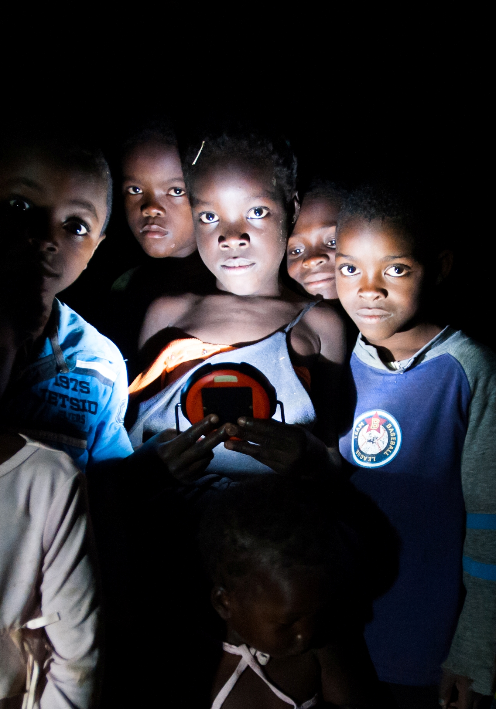
A solution: mend market failure
SunnyMoney, wholly owned non-profit
Catalyse demand and seed market
Work with head teachers to promote lights to the parents of students
1st stage of ‘bottom up’ market-building
Notes:
SolarAid created SunnyMoney, our non-profit social enterprise – to distribute solar lights in rural areas of Africa where people have no access to electricity and are relying on kerosene for lighting.
- We work with the Ministry of Education, alongside teachers to offer lights to school children at a subsidised rate. We know that this is a great way to reach out to people and spread the impact of clean, affordable lighting throughout the community.
- Our aim is to build a market for these solar lights – we believe in business-based solutions to address this problem. If we build a market then manufacturers and suppliers will be interested to enter the market, to research and develop, to improve quality and meet the demands of the customers. That also means that there will be competition, which ultimately pushes price down and quality up which then makes the lights more accessible to the poorest.
- We believe building a market is a more sustainable and effective way of ensuring access to these solar lights.

Slide 13
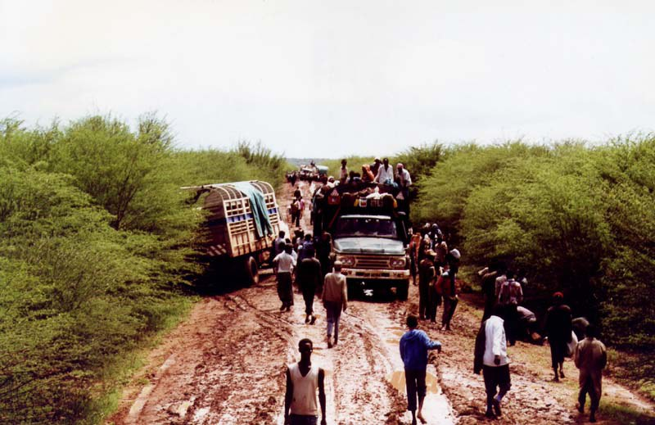
Market-building: Challenges
Price barriers ($8 up front v 20c a day)
Trust / awareness of technology
Quality / resilience
Last-mile distribution / lack of retail and transport infrastructure
Notes:
Price: even though the price of the solar light is normally recouped after just a few weeks of use (from reducing kerosene spending), having a lump sum of money can be beyond the reach of many rural Africans. We are working on finance solutions like rent to own, paying in instalments and pay as you go mobile technology to address this issue.
Trust and awareness: Would you buy a product you knew next to nothing about? Probably not. Would you buy something you’d never really been aware of before? Almost definitely not! The likelihood of you saying ‘yes’ to these questions is probably directly linked to how much income you have – if you have low income and little financial resilience, you can’t afford to take a risk on the unknown.
This is SolarAid’s catch 22. The people in Africa who could most benefit from the solar lights, are those that are most averse to risk – the ones with the lowest incomes. Whilst they are spending a large proportion of their income on kerosene for lighting, that’s something they’re familiar with and is a 20c a day expenditure that fits their financial context. If they bought one solar light and stopped using one of their kerosene lamps, not only would they get brighter and safer light, but they would also save money. The energy from the sun is free after all.But if that light failed, they would have made a massive and disastrous investment that could spell disaster. In a country where there are a lot of fakes, aftersales support and consumer rights are almost unheard of, and advertising to build trust is non-existent; encouraging customers to make this massive change to switch to solar is difficult.
Quality: there is an amazing sense of innovation and creativity in Africa which is great, but also means that there are often fake products which are unsafe and unfit for purpose. The World Bank and IFC have a joint initiative called Lighting Africa and we tend to only supply products that are Lighting Africa approved – this means they’ve gone through some rigorous tests and are deemed of high quality.
As the biggest seller of solar lights across Africa, we’ve got quite a bit of influence with manufacturers now. So, if our customers are telling us that they’re having problems with their lights, you can bet the manufacturers will hear about it from us.
Last-mile distribution is a real challenge in rural Africa not only because of the poor infrastructure, but also because of low population density in some areas meaning it isn’t cost effective to reach everyone. We’re not giving up on these people, but we recognise it’s a challenge to be sustainable and reach these people. That’s why we’ve developed our programme to deliver through community channels and using a hub approach.. In stage 1 of our market build, we invite the head teachers of a group of schools to come and find out about the lights and then they deliver the message to their school – this means the message is being relayed by a trusted member of the community and is immensely time and cost effective – allowing us to get lights out at massive scale - as we don’t have to visit every single school individually.

Slide 14
The big mission:
Eradicate the kerosene lamp from Africa by 2020
If Nigeria used modern off-grid lighting, it could save over US$1.4 billion annually. Replacing all kerosene, candles and batteries would save Nigeria the equivalent of 17.3 million barrels of crude oil. (UNEP 2013)
Notes:
If we looked at the potential benefits to a nation, or even the continent, that we could see as a result of swapping kerosene for solar, it is profound.
Productivity --- through better health and increased available lighting hours
investment in livelihoods as disposable income rises --- from reduced kerosene spend, and
improved education --- thanks to motivation and increased study hours
would all contribute to economic and social development.
That’s why we believe that making affordable and clean solutions to lighting in Africa available is a key strategy for overcoming one of the biggest challenges facing the developing world today.

Slide 15
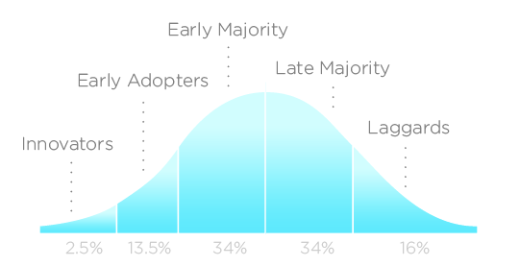
Diffusion of innovation: Stages
Notes:
SunnyMoney has an ambitious 7 year business plan to 2020 during which it will grow the market via a phased channel strategy:
To reach early adopters: Breed trust / seed market via schools and community channels – 13.5%: warranties, establish SM as a brand of trust, get lights shining and let people witness the benefits with their own eyes and ears
To increase penetration: Resolve access to finance / affordability (SunnyMoney Brains is our innovation unit that is constantly developing and piloting new market approaches, such as mobile PAYG)
To protect the sector:– drive and protect QS, drive the imperative for fair market pricing, conduct research and knowledge sharing, tackle cross-cutting sector issues such as pico design, manufacture base / import strategy, recycling and waste management
To increase community penetration: recruit community distributors (early majority → Google Tanzania) back up entrepreneur efforts with call centre support / media and radio / lead generation (from schools campaigns)
CONTD

Slide 16
SunnyMoney:
500,000 lights sold across
five countries
200m
Other market players
Generates 25% of all SSA light sales. Now largest distributor in SSA
SolarAid supporting the sector
50m
Notes:
We perceive the tipping point / saturation to be at 2016/17 and we will have paved the way for multiple players to come and join the market, mopping up sales from the late majority.
Leadng up to this point, SolarAid will (In parallel) lobby governments and trigger public health programmes; and foster knowlege to support new market entrants (tipping point 2016/17)
The final stage will be solar shops and distributors right across the continent (serving the late majority / laggards)
By 2020,: Solar lights will be as ubiquitous as kerosene (SolarAid / SunnyMoney 24-28% of market, 4:1 provided by other players)
Total cost to catalyse £20m - £30m (incl support for other entrants and innovation, public health campaigns
We are preparing for our first ‘big ask’ of £20m to enable SolarAid/ SunnyMoney to kick-start the market and continue the scales roll out of pico solar
In future:
Made in Africa (assembly / production)
Modular / challenge western assumptions of built in obsolescence / different modular solutions
Recyclable / cradle to cradle
Pay-as-you-go
Tech innovation – PVs, battery, light capability, TVs, laptops, radios, fridges, washing machines, cook stoves, air filtration / cooling, community lighting – the power of pico!
Micro-generation + energy efficient appliances = low carbon growth. Leap-frog grid dependency and ‘energy escalator’ unconscious consumption … Africa can show the world how it’s done.

Slide 17
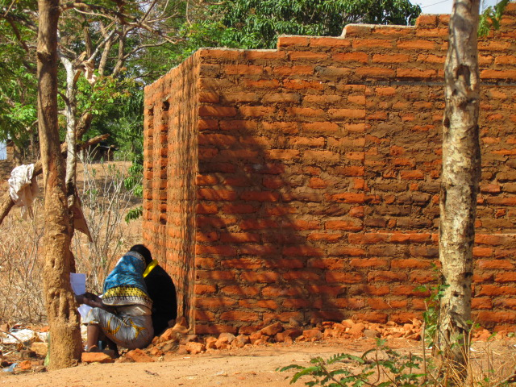
Two brands: One Mission
INNOVATE
1. Sharing & Learning: New ideas are piloted at small scale to see if they work
SHARE & SCALE
2. Continue to enhance and improve the SunnyMoney model
3. Help others enter the market, encourage them to replicate our approach
4. INFLUENCE POLICY and SECTOR DEVELOPMENT to support market growth.
5. Build an alliance for the Right to Clean Light. (the new water)
Building a Market + Influencing Policy
= Impact + Sustainability
Notes:
At SolarAid we have just started our research work and we do it for a number of reasons:
learning for programme improvement so we can adjust our programme delivery and it can feed into design and strategy
monitoring of progress towards our goal – constantly challenging conventional wisdom (or fllling gaps) across all aspects of pico solar market building / products / usage / adoption etc
measuring and sharing impact so we can tell people how important our work is and raise awareness of the issue and show the world there is a fast affordable solution
As well as specific university-led research, we conduct our own field research using a variety of methods and with as many relevant stakeholders as we can using Research Assistants based in our country programmes:
Surveys with the public to find out about general awareness of, trust in and interest in solar lighting
Interviews with customers with solar lights to find out how they’re using the light, how it has affected their lives
Interviews with head teachers at schools where pupils have bought solar lights to find out whether lights have affected educational outcomes for their students
Focus group discussions with solar light and non-solar light users to better understand and target people
Market observations to find out if we really are building a market i.e. are there shops to buy these affordable lights in?
Plus desk research into impacts across health, education, macro- and micro- economic effects environmental impacts, policy and development areas

Slide 18
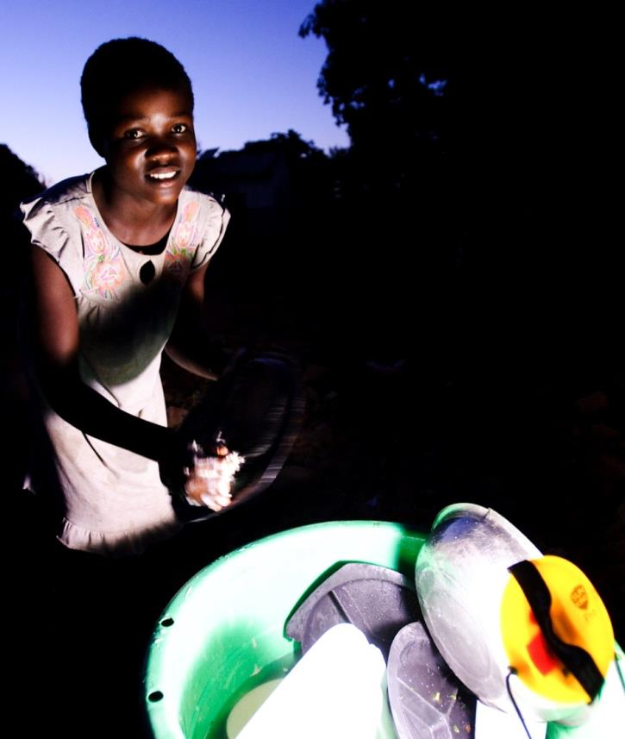
Trade not aid: a new approach
A positive example
Combining competition with collaboration; no ‘turf wars’
Commercial focus on scale / efficiency but otherwise 100% focused on social & environmental goals
Profit making enterprise with perpetually revolving fund
New breed of ‘renaissance company’ - could help the world live within resource limits
Re-writing the approach to finance / grant-funding / aid

Slide 19
Collaborative partners: can you help?
Conducting research
Health
Market futures
Piico products (laptops, TVs)
Funding areas
Market-building / SunnyMoney
Sector support / lobbying
Public health messaging
Research & Innovation (SunnyMoney Brains)
Influencing stakeholders
Energy Policy (eg fuel subsidies)
Ease of trade / business / entrepreneurship
SolarAid support
Pro bono / expertise sharing (articles, technical, research)
Rag and campus engagement
Education
Economics
Environment,
Energy & enterprise policy
Grid dev; investment
Technological advances
Materials and components
Product innovations
Manufacture
Import and distribution
Market conditions (Import, VAT on solar)
Pico solar support
Advocate and amplify
Join in the fun!
Donate schemes (GAYE)

Slide 20
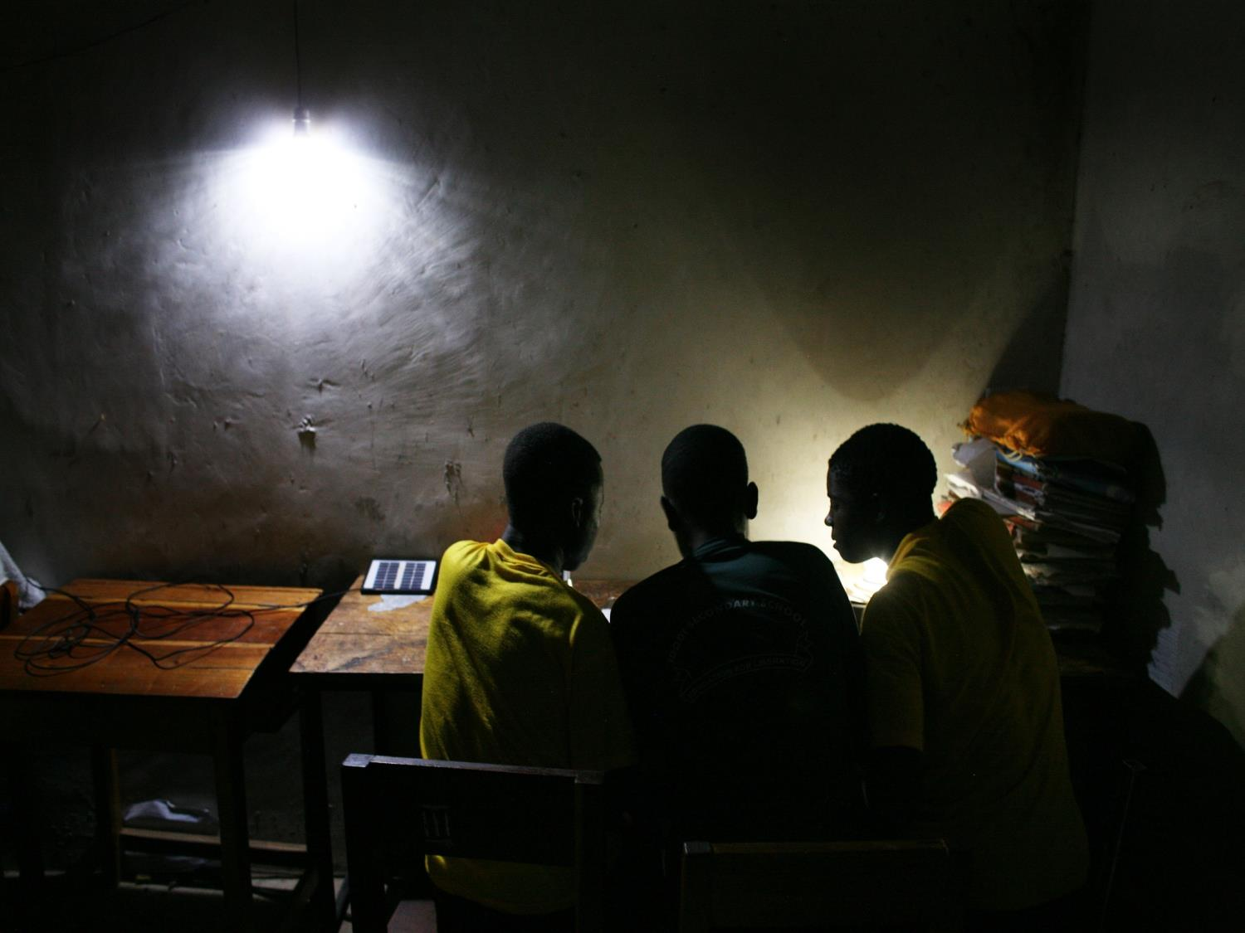
Thanks
Website: www.solar-aid.org
Email: pippa.palmer@solar-aid.org
Notes:
Thanks
I know we’ll be having questions afterwards, but if you want to get in touch with any questions or would like to get involved at all, then you can find me here.

Slide 21
Sources
Visible Earth NASA (http://visibleearth.nasa.gov/view.php?id=55167)
Lighting Africa 2013 (http://www.lightingafrica.org/)
A NEW GLOBAL PARTNERSHIP:ERADICATE POVERTY AND TRANSFORM ECONOMIES THROUGH SUSTAINABLE DEVELOPMENTThe Report of the High-Level Panel of Eminent Persons on the Post-2015 Development Agenda
http://www.guardian.co.uk/world/2012/apr/01/overseas-aid-africa-oil-imports-costs
Black Carbon and Kerosene Lighting: An Opportunity for Rapid Action on Climate Change and Clean Energy for Development:
Arne Jacobson, Director, Schatz Energy Research Center, Humboldt State University:
Nicholas L. Lam, PhD Student, Department of Environmental Health Sciences, University of California, Berkeley:
Tami C Bond, Associate Professor, Department of Civil and Environmental Engineering, University of Illinois at Urbana-Champaign:
Nathan Hultman, Nonresident Fellow, The Brookings Institution and Associate Professor, School of Public Policy, University of Maryland:
APRIL 2013 The Brookings Institution 1775 Massachusetts ave., Nw washington, Dc 20036

