Slide 1

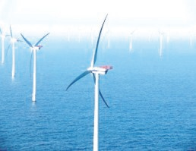
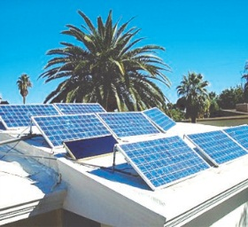
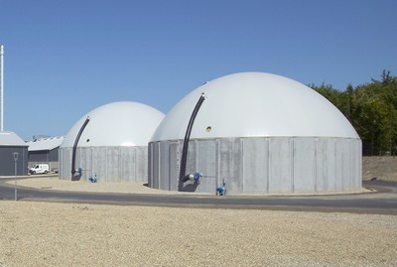
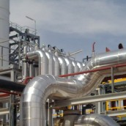
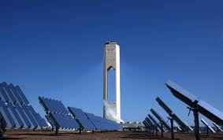

Financing of Low Carbon Energy (LCE) by Private Financial Institutions (PFIs) in Africa.
Dr. Tim Koomson (UNU-INRA)
Joint UNU-INRA And African Development Institute (ADI) of The African Development Bank (AfDB) Project.

Slide 2
OUTLINE
Background and Context –International funding for LCEs in developing
Filling the gap in financing for LCE
Sound Bites of Opportunities
Scoping Study
Methodology
Preliminary Findings
How are PFIs integrating sustainability issues in their
corporate operations and portfolios in Africa?
What are the nature of financial transactions of PFIs for projects in energy efficiency (EE) and renewable energy (RE).
How are PFIs incorporating EE and RE into their products development, business development, capacity development, credit analysis and risk management?
What are the major constraints and challenges?

Slide 3
Source: OECD/DAC

Slide 4
Notes:
Multilateral provides 27 per cent; Bilateral 73 per cent

Slide 5
Source: OECD/DAC

Slide 6
Source: Climate Funds Update
Notes:
The Climate Investment Fund (CIF) is made up of two multi-donor funds - the Strategic Climate Fund (SCF), and the Clean Technology Fund (CTF). As shown in Figure 5.4, the CIF has approved about US$ 760 million in total. Less than US$ 1 million has been disbursed. The CTF has a more decentralized fund management arrangement at the regional banks. The CTF for Africa is managed by the AfDB. It provides financial support for promoting low-carbon technologies through demonstration, deployment and technology transfer. It became operational in 2009 and it has approved about US$578 million projects in Africa, none of which has been disbursed.
Scaling-Up Renewable Energy Program in Low Income Countries (SREP). Global Energy Efficiency and Renewable Energy Fund (GEEREF) are multilateral funds by European Union (EU) member countries.
GEEREF is focused on using public funds to leverage additional private funds through Public-Private Partnership (PPP). It is structured as a fund of funds and invests in private equity sub-funds such as the Frontier Market Energy & Carbon Fund (FMECF) managed by the Denmark-based Frontier Investment Management and the Evolution One Fund managed by the South African-based Inspired Evolution Investment Management. The FMECF is a EUR 60m fund with a focus on renewable energy and assets that will generate carbon credits in Sub-Saharan Africa (SSA).
SREP became operational in 2009. It is intended to demonstrate how low carbon energy projects in low income countries could be viable. As of April 2012 when the fund updated its information, it has not yet disbursed any of about US$34 million approved projects.

Slide 7
What is the cost of LCE transition in Africa

Slide 8
The role of PFIs in financing LCE in Africa.
Substantial amount of investment will be needed to promote LCE in Africa.
Private financial institutions (PFIs) such as commercial and investment banks, insurance and leasing companies, pension, trust, retirement and private equity funds have key roles to play in providing the required financial resources to help implement these technologies in Africa.
However, several PFIs in Africa still structure their operations and portfolios along the traditional way of doing business.

Slide 9
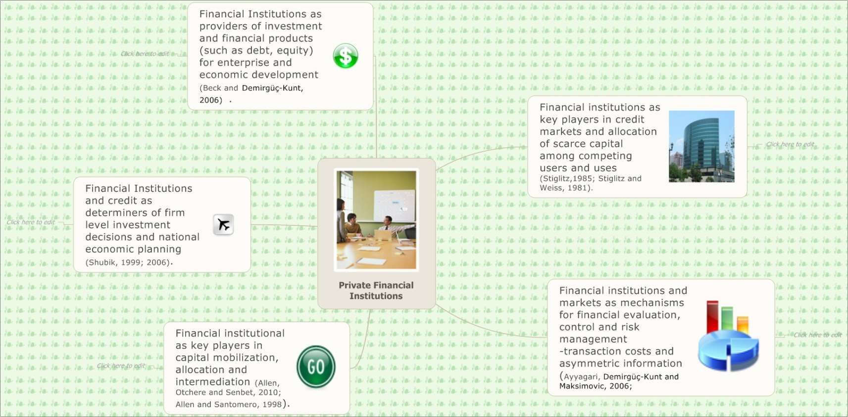
Theory of Financial Institutions and Economic Development

Slide 10
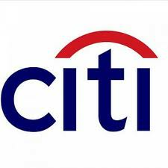



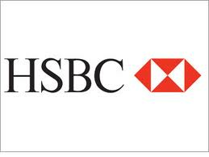
Sound Bites of Opportunities
We have committed 50 billion dollars, more than any other institution, over the next 10 years for climate-friendly efforts."
“Financing low carbon technology represents a unique opportunity for banks to benefit from the significant growth of the low carbon technology sector whilst demonstrating a positive contribution in tackling climate change”
“We have completed $8.4 billion toward our $20 billion environmental commitment, committing $5.4 billion in lending and investing activities and facilitating nearly $3 billion in capital markets activity”
“the shift to a low-carbon economy requires finance which presents an opportunity to HSBC”.

Slide 11
Scoping Study Methodology
Institution | # | (%)
Banks | 30 | 40%
Leasing Companies | 6 | 8%
Insurance Companies | 13 | 17%
Other PFIs | 3 | 4%
Industry | 4 | 5%
Government | 19 | 25%
Total | 75 | 100
Scoping study -take stock and review financial instruments that are currently developed or under consideration to support EE, RE, clean and low carbon technologies in Cameroon, Ghana, Tanzania, Tunisia and Zambia.
Structured questionnaire for banks, insurance, leasing other PFIs and governments.
Informal consultation and discussion. Review of relevant materials.

Slide 12
What are the nature of financial transactions of PFIs for LCE projects?

Slide 13
How are PFIs integrating LCE Financing into their operations?

Slide 14
SOME CONSTRAINTS
Most PFIs interviewed have realized the opportunities available for attracting low-cost funds with discounted interest rates and longer tenor from risk capital funds and multilateral banks for financing such instruments. However, they have not taken advantage of these opportunities due to lack of knowledge and capacity to structure, analyze, and manage financing and investments in these instruments.
Two banks ( 1 in Ghana and 1 in Tanzania) have lost low-cost funds from a multilateral bank and a DFI respectively because they lacked the knowledge and capacity to structure and manage EE/RE financing
Some of the major constraints given for not integrating financing for EE, RE, clean and low-carbon technologies in for example products and services development are lack of awareness, lack of capacity, low client awareness and demand, mismatch between financing long-term assets with short-term deposits, perceived high credit risks, high interest rates, complicated structuring processes, lack of incentives, enabling policies and legal framework from governments.

Slide 15
SOME CHALLENGES
Banks in Africa normally invest in government securities such as treasury bills. Very dysfunctional banking intermediation that shuns provision of private credit in favor of safer government securities (Allen, Otchere & Senbet, 2010)
One of the major reasons for low or lack of financing for EE, RE, clean and low-carbon technologies in PFIs lending portfolios (current and pipeline) is their inability to use short-term deposits to finance these instruments which are usually on medium- to long-term tenor. The availability of low-costs funds at discounted rate of interest and longer tenor will provide solution to this problem of mismatch between short-term deposits and medium/long-term lending.
However, to take advantage of these international funding opportunities they have to enhance their knowledge and capacity to structure, analyze and manage such financing. This underlies the next phase of the project to develop training manual for such knowledge and capacity enhancement activities in Africa.

